Slide 1

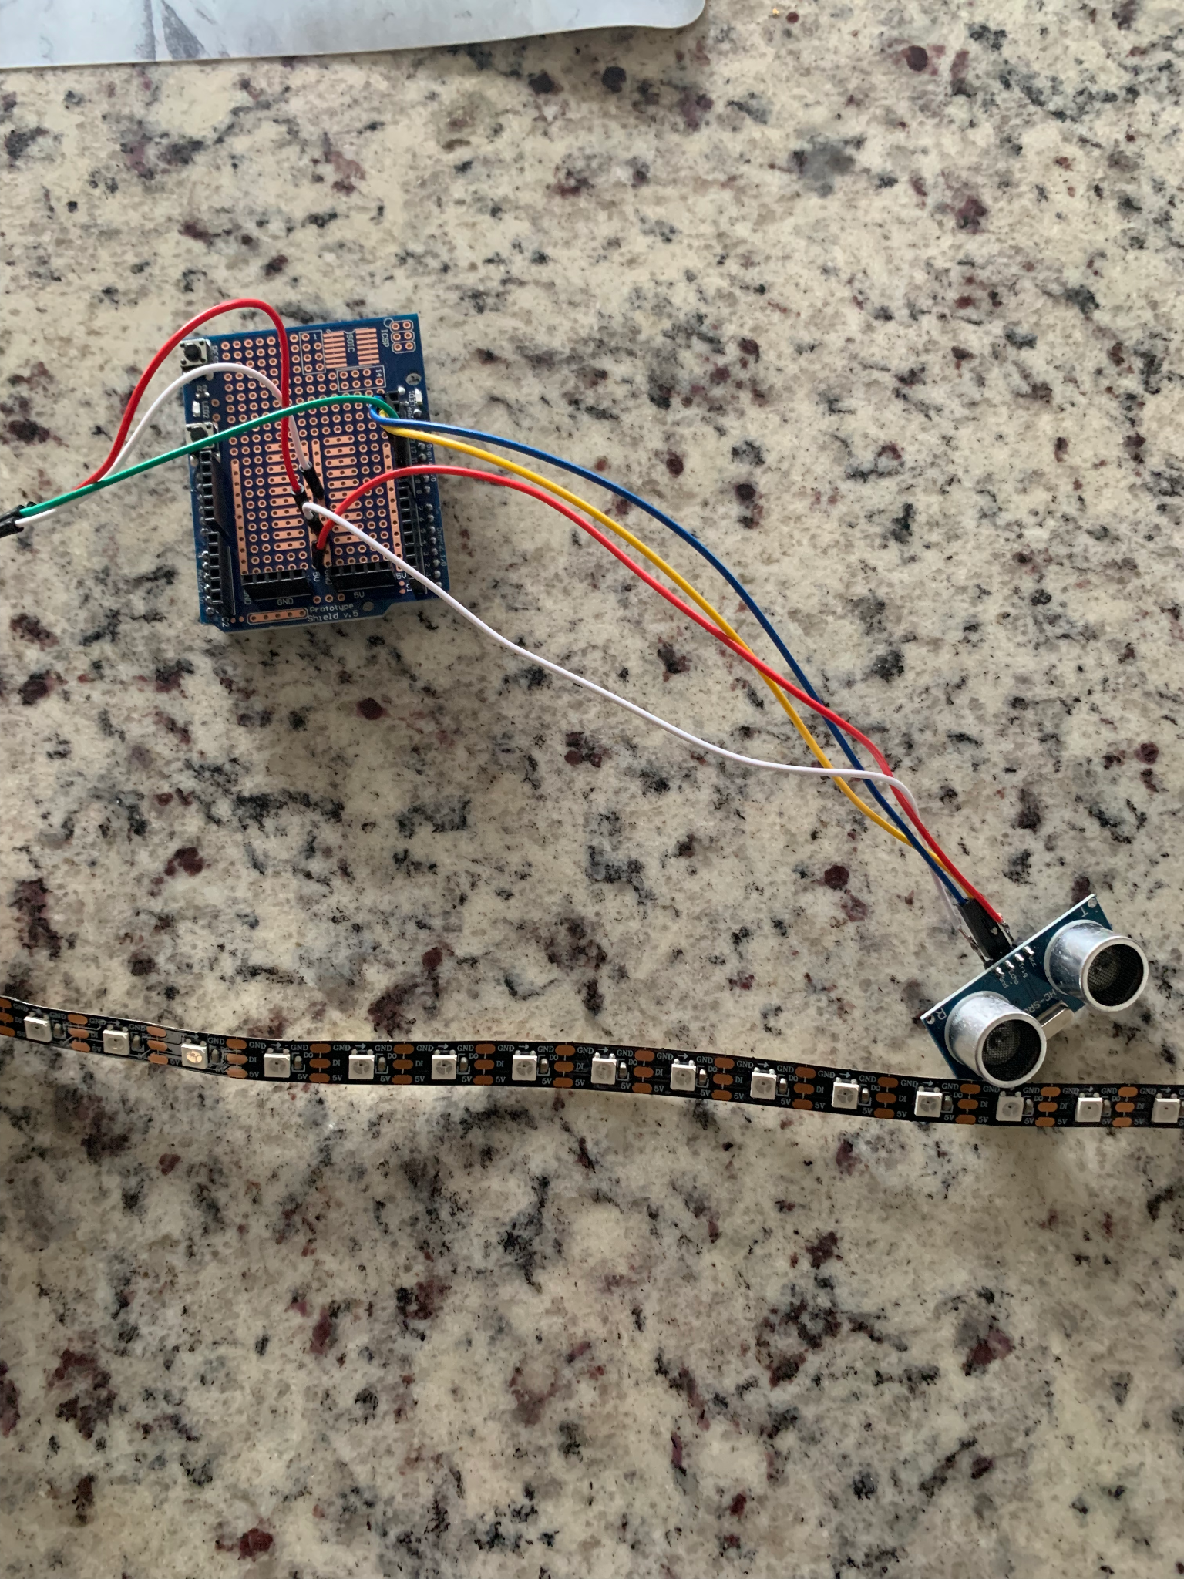
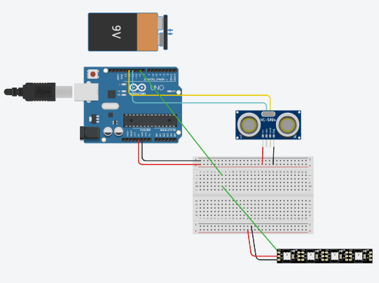
Parking Assistant
Amara Tariq
GIMM 280 Physical Computing Project
INTRODUCTION
COMPONENTS
People often struggle to find the perfect distance to park their cars from the end of their garage. Sometimes they park too close so people can’t pass from the front, sometimes too far so that they can’t open their trunks without opening the entire garage. This device can detect the distance between the car and wall and then let the diver know via lights how close they are. It can also be altered and personalized for each person’s ideal parking distance.
Ultrasonic Sensor
used to detect the distance of the approaching vehicle from the wall
Individually Addressable LEDs
used to visually output to the driver relatively how close they are getting to the perfect parking position
INPUT AND OUTPUT
Inputs
Ultrasonic Sensor
Outputs
Individually Addressable LEDs
CONCLUSION
Photo of the completed project.
Overall, the project runs perfectly. Alterations were made to the distance checks to allow demoing in a smaller space, but these are values that a user can easily alter to suit their own garage.
I would want a more stable ultrasonic sensor to help enable using smaller increments. That way the user could really set each increment to an LED and overall would help in accuracy.
Another interesting addition would be to add a noise output, with pitches changing along with the LEDs.
The project would also benefit from having a solid housing unit.
ARDUINO CODE
if (distance < 20){
for (int i = 1; i <= NUM_LEDS; i++) { //reset all LED
leds[i] = CRGB(0, 0, 0);
}
for (int i = 0; i <= 0; i++) { //turn on two from the middle
leds[(NUM_LEDS / 2) + i - 1] = CRGB(159, 43, 104);
leds[(NUM_LEDS / 2) - i] = CRGB(159, 43, 104);
}
FastLED.show();
delay(50);
}
This is one of the distance checks, and depending on the distance, we light up a certain amount of LEDS Lavender. This is done starting from the center of the LED strip.
Photo of the circuit board or a schematic diagram of the circuit

